Slide 1
Institute of Demography NRU HSE
Research Workshop, 9 February 2015
How they should not write research papers (course papers, Master’s papers)
Eugeny Soroko
Version 2.0 (English) of 1-Dec-2015
Version 1.1. (Russian) of 6-Feb-2013

Slide 2
Institute of Demography NRU HSE
How they should not write research papers (course papers, Master’s papers)
Why this topic appears?
A lot of remarks to course papers, essays, Master’s and research papers.
- Repetition of the same errors in the papers of students from different universities and faculties.

Slide 3
Institute of Demography NRU HSE
How they should not write research papers (course papers, Master’s papers)
What is this workshop for?
Aims:
To analyze specific examples of basic errors in essays.
To perform classification of their different types.
To discuss possible ways how to eliminate them.

Slide 4
Institute of Demography NRU HSE
How they should not write research papers (course papers, Master’s papers)
Where to begin?
What is essay?
Essay (some synonyms) –
sketch, exercise, trial, tractate, test
in NRU HSE – a written work sheet a student prepares on the topic selected. It must display that he or she has good command of the subject, efficiency of independent work, and articulate scientific ideas.

Slide 5
Institute of Demography NRU HSE
How they should not write research papers (course papers, Master’s papers)
Structure of essay
On the diagram – example of one essay with
1,2,3 – completely correct estimates, theories, citations, statistical data taken from reliable sources.

Slide 6
Institute of Demography NRU HSE
How they should not write research papers (course papers, Master’s papers)
Error No 1
– Full absence of your own point of view.
Method of elimination:
Significant part of the essay must be devoted to presentation of your own point of view, its illustration, and argumentation of the basic statements.

Slide 7
Institute of Demography NRU HSE
How they should not write research papers (course papers, Master’s papers)
Structure of essay
On the diagram
1 – a single source used,
2 – an own point of view.

Slide 8
Institute of Demography NRU HSE
How they should not write research papers (course papers, Master’s papers)
Error No 2 – only a single source was used. It may be the most recent publication, very interesting for the student. He or she shares its point of view and wants to use in the essay.
Danger: This single publication clarifies only one aspect of the problem. It may be preconceived, one-sided, or even erroneous. Alternative points of view are absent.
Method of elimination:
At least 3 to 4 sources are recommended to use.

Slide 9
Institute of Demography NRU HSE
How they should not write research papers (course papers, Master’s papers)
What subject to select?
Error No 3 – the topic selected is too broad.
Danger:
It is impossible to develop a theme on 7-9 pages.
Examples:
«Peculiarities of migration in the European countries in the 1990s – 2000s»
«Demographic situation in Russia in the end of 20 – beginning of the 21 century»
«Population policy in the countries of Asia»

Slide 10
Institute of Demography NRU HSE
How they should not write research papers (course papers, Master’s papers)
What subject to select?
Error No 3 – the topic selected is too broad.
Method of elimination:
- minimize the number of countries, but not less than to 2 in order to provide the opportunity of inter-country comparisons
another way of topic selection is to narrow the list of features under analysis in the demographic processes. E.g. for migration you may consider only educational migration.
shorten the calendar period under consideration

Slide 11
Institute of Demography NRU HSE
How they should not write research papers (course papers, Master’s papers)
What subject to select?
Error No 3 – the topic selected is too broad.
Examples of more appropriate topics:
«Educational migration in Sweden, Norway, and Denmark in the 1990s – 2000s»
«Mortality trends in the population of Ukraine in the post-Soviet period»
«Comparison of family policy in France and Sweden»
«Migration patterns in Belgium and Germany in the end of the 20 century»

Slide 12
Institute of Demography NRU HSE
How they should not write research papers (course papers, Master’s papers)
How to justify the statements of the essay?
Error No 4. The essay contains nice and serious theories, opinions, approaches, but they are validated by nothing.
Why it is important? Demography is the science located at the intersection of social and exact sciences. The reasons required are not only the qualitative but the quantitative ones.
Techniques for solving the problem: The essay should contain tables, diagrams, maps, graphs, and specific statistical data to justify its statements.
At least one table and one graph is required to provide positive grade for the essay.

Slide 13
Institute of Demography NRU HSE
How they should not write research papers (course papers, Master’s papers)
What is the optimal size of citation?
Even the most significant, interesting, useful source may be utilized, but in compliance with a sense of proportion.
Error No 5. Reprint of big portion of text from one source in the essay – up to 2-3 pages without abbreviations.
Why this blunts the general effect of the essay? Such citation is the indirect confirmation that the student failed to define the most significant statements on the topic selected.
How to solve? We recommend to find, select and use the portions of citation sized not more than 2-3 paragraphs from one source.

Slide 14
Institute of Demography NRU HSE
How they should not write research papers (course papers, Master’s papers)
Plagiarism
Using of the best theories, precise statements, and comprehensive reasoning without any reference to the source must be considered as PLAGIARISM, that is the acquisition of authorship.
Not simply the error No 6. Plagiarism is the basis to obtain no positive grade for essay, diploma, or dissertation or even student’s dismissal.
How to discover plagiarism? Search engines, system Antiplagiarism in NRU HSE. Experience of the lecturer is significant as well. Sometimes the cases of plagiarism may be discovered many years on.
How to escape? In the cases of citation both of text or data the source must be explicitly specified.
Example of plagiarism in the science at Demoscope: http://demoscope.ru/weekly/2005/0225/plagiat.php

Slide 15
Institute of Demography NRU HSE
How they should not write research papers (course papers, Master’s papers)
References and citation
Demands to references and citations in diploma or essay do not differ from these demands in scientific papers.
Error No 7. Disregard of these rules.
Example Медков. Демография. [Medkov. Demography]
Why that is wrong? The book may be published in different editions in different time in different places. The reader may fail to find required citation in another publication.
Correct В.М.Медков. Демография. Учебное пособие. Ростов-на-Дону, "Феникс", 2002, с.33. [V.M.Medkov. Demography. Textbook. Rostov-on-Don, “Feniks”, 2002, P.33]

Slide 16
Institute of Demography NRU HSE
How they should not write research papers (course papers, Master’s papers)
References to Internet
Error No 8. Inexact references to sites.
Examples 1) Wikipedia 2) Demoscope http://demoscope.ru
What is wrong?
1) URL address is not specified, what kind of Wikipedia used is not clear (Russian, English, French,…)
2) The type of information and title of the source is not given.
3) The date of access to a given page is not specified.
Correct:
1) Wikipedia http://en.wikipedia.org/wiki/Battle_of_Stalingrad (accessed on 02.02.2002)
2) Survivors to 60 will survive on average 20 years more. World demographic barometer. Demoscope Weekly
№ 539 - 540 http://demoscope.ru/weekly/2013/0539/barom02.php (accessed on 03.03.2003)

Slide 17
Institute of Demography NRU HSE
How they should not write research papers (course papers, Master’s papers)
Is the information really recent?
Error No 9. Out-of-date data (=Junk, Lumber)
Example The essay entitled «Contemporary demographic situation in Kazakhstan» and written in 2012 contains statistical data for 2004 and before.
What is wrong?
The author did not try to find more recent data for the period 2005-2010.
The word “contemporary” becomes misplaced.
A suspicion appears that the author used only outdated sources.
How to correct?
It is required to find more fresh, recent data, update and correct the tables, graphs, as well as the results of demographic analysis.

Slide 18
Institute of Demography NRU HSE
How they should not write research papers (course papers, Master’s papers)
Per thousand or per cent?
Error No 10. % instead of ‰
Example «Mortality rate in China was 25 %.»
This error was met in dozens of essays from year to year.
What is wrong? The unit of measurement and scale used are incorrect, the name of indicator is inaccurate.
How to correct?
To check up the statistical data given with the formulas for calculation of indicator.
To get an insight into the margins of the given demographic indicator not only for the country under consideration, but in other countries of the world and neighboring regions.
Correct Crude mortality rate for population of China was 25 ‰ per year.

Slide 19
Institute of Demography NRU HSE
How they should not write research papers (course papers, Master’s papers)
How the indicator is measured?
Error No 11. Unit of measurement is missed for the indicator or is given with error.
Where is the problem? In this case comprehension of this indicator may become ambiguous or erroneous. It may be measured in years, percents, in other units.
How to solve? There is only one way to avoid such ambiguity – the unit of measurement must be explicitly specified in the text and in the name of table or graph
(year, per cent, thousand persons, household, etc.).

Slide 20
Institute of Demography NRU HSE
How they should not write research papers (course papers, Master’s papers)
Trust and verify!
Error No 12. Unreliable data source was used.
Example A general Internet search engine was used to define the size of population of Latvia. (It was “googled”).
Where is the problem?
It is difficult to select a reliable source from 2 million found.
Many of them are outdated or incorrect.
What is the correct way?
To use the most reliable sources of data.
Rosstat, Eurostat, Demoscope,
National statistical agencies,
Databases of UN organizations,…
See links at Demoscope http://demoscope.ru/weekly/app/links.php

Slide 21
Institute of Demography NRU HSE
How they should not write research papers (course papers, Master’s papers)
«IS IT EVIDENT THAT…» to all?
Error No 13. The arguments used in the essay are of the types
IT IS EVIDENT THAT…
IT IS OBVIOUS LONG AGO THAT…
WITHOUT ANY DOUBT…
What it the problem? The reason brings a sense of intuitive, unscientific character. Multiple historical examples display their unreliability. Example – before Galileo it was evident for all that the Sun moves round the Earth.
How to correct? To use various types of sources for reasoning and justification of statements: textbooks, census results, scientific papers, population indicators from the databases.

Slide 22
Institute of Demography NRU HSE
How they should not write research papers (course papers, Master’s papers)
In English or in French?
Error No 14. Some country names, regions, indicators are given in Russian, some – in English, some – in French…
What is the porblem? The author displays disrespect to the reader and reluctance to make an effort and translate the key terms in Russian (English, French,…). Must really every reader be a polyglot?
How to escape? To write the paper in one language.
You may do that in Russian or English, but the language must be ONE within the limits of one paper.
Of course, it may be even Chinese,
but who will check it? ☺

Slide 23
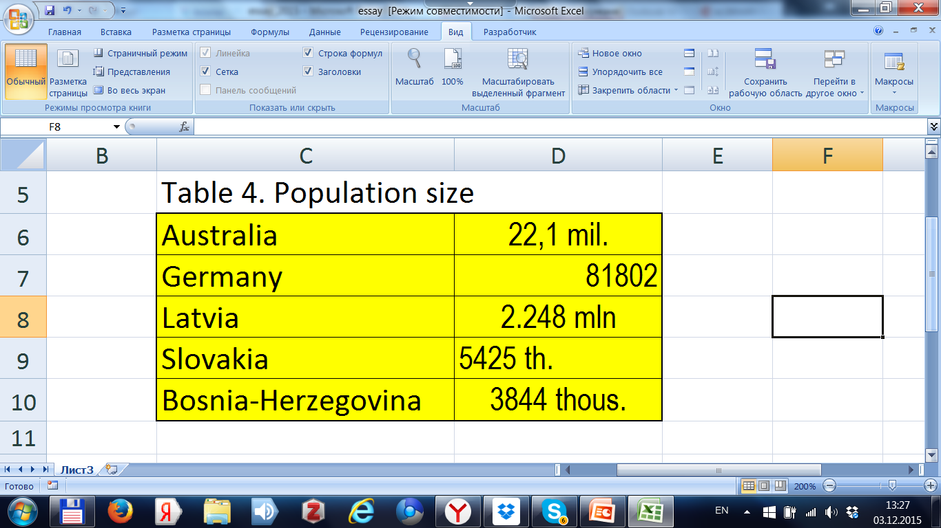
Institute of Demography NRU HSE
How they should not write research papers (course papers, Master’s papers)
How to draw up a table?
Error No 15. Appearance of tables is untidy.
What is the problem? The author forget that figures are not worse than the soldiers at the parade, and must be lined up.
Example of bad table

Slide 24
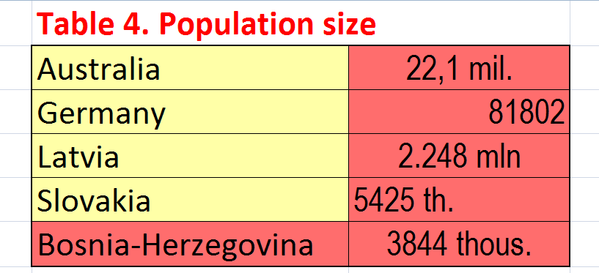
Institute of Demography NRU HSE
How they should not write research papers (course papers, Master’s papers)
How to draw up a table?
What are the errors in No 15?
Errors in the table name.
No column headers
Error in the country name.
Errors in a short name of unit.
Different units for different countries.
Different alignment of figures in the cell.

Slide 25
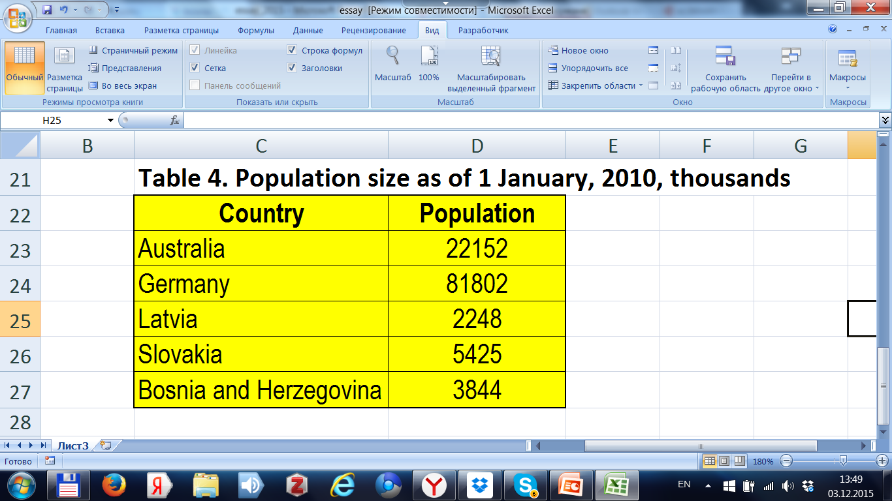
Institute of Demography NRU HSE
How they should not write research papers (course papers, Master’s papers)
How to draw up a table?
Sample of correct table

Slide 26
Institute of Demography NRU HSE
How they should not write research papers (course papers, Master’s papers)
Dissonance between the topic declared and the content of essay, excess of details
Error No 16 Is it possible to answer all the questions in one paper? Are all the details required?
Covering the topic does not become better when you try to deal with details. Example: at describing contemporary migration in the European countries you do not need to digress to the problems in Nicaragua or Brazil in the 20th century.
Danger: Failure to follow the demands to volume of essay. Excess of details obstructs and litters the main statements.
Kozma Prutkov: «Nobody can embrace the unembraceble.»
Possible solutions
Do not digress, write more close to the country, people, topic, and process selected, … and highlight the key points.

Slide 27
Institute of Demography NRU HSE
How they should not write research papers (course papers, Master’s papers)
Impossible value of indicator
Error No 17 Examples: Probability more than 1
Percentage of age group more than 100
Negative mortality rate
Family size equal 1
Infant mortality rate 2 per 1000 life births in 1950
How to escape?
- To start checking the values with defining the range of variation for each indicator according to its content
- To proceed to reduction of the set of possible values for the real historical subpopulations
- To estimate correspondence of selected values to these for neighboring countries or close demographic groups

Slide 28
Institute of Demography NRU HSE
How they should not write research papers (course papers, Master’s papers)
Incorrect translation of a term
Error No 18 may appear as in any other branch of science, in particular owing to misleading words. But not only.
Try to make verbatim translation of the term «Life table».
How to make correct translation?
- To find publications the most close to Demoscope by the theme, where the corresponding demographic process is being analyzied.
- To find the initial term in Demopaedia for example in English, then using the left language menu move to the analogue in Russian, French, German,…
http://en-ii.demopaedia.org.

Slide 29
Institute of Demography NRU HSE
How they should not write research papers (course papers, Master’s papers)
June or May fertility?
Error No 19 – amusing example of incorrect use of correct values of the indicator required. Values «1.5», «1.6» from English Windows or database after import into Russian Excel is converted to «1 мая», «1 июня». Or vice versa as well.
Comment Decimal delimiter in English is “.”, in Russian – “,”
How to obtain correct result?
- Correct decimal point into “,” by hands if the number of figures is small (1-3).
- If more – save in a file, make global replace «.» by «,» in it, save the result, open it in Russian Microsoft Office.
- And anyway … attentively read what was written at least once…

Slide 30
Institute of Demography NRU HSE
How they should not write research papers (course papers, Master’s papers)
Mass media as the primary source?
Error No 20 – using mass media as a source of demographic information.
Why this is an error?
Modern mass media suffers from various types of inaccuracy, inexactness.
Authors may be illiterate in population studies.
Editorial boards look toward sensation at any cost.
It is worth nothing for them to mix up % and ‰, thousand with million, make a 10-fold mistake at dividing of figures, or even simply bend the truth.
How to escape?
Do not use mass media as the primary source.
Select the most reliable ones: Eurostat, Rosstat, UN, WHO,…

Slide 31
Institute of Demography NRU HSE
How they should not write research papers (course papers, Master’s papers)
How the source of data must be given?
Error No 21 – using the reference to the source such as:
«Источник: Росстат» [Source: Rosstat].
Why this is an error?
Rosstat (Federal Service of State Statistics) has wide range of paper and electronic means for dissemination of statistical information: yearbooks, reports, databases, Internet sites, and periodicals.
With no specific data source given the user’s question remains what was it.
The values of one indicator may differ in different sources!

Slide 32
Institute of Demography NRU HSE
How they should not write research papers (course papers, Master’s papers)
How the source of data must be given?
Error No 21 – reference such as «Источник: Росстат».
Example of ambiguity
Table 2. Net migration for population of Russia in 1997 according to different sources, persons.
Source | Net migration
Information on socio-economic status of Russia, 1997 | 364600
Demographic yearbook of Russia 2002, T.1.3 | 352600
Demographic yearbook of Russia 2009, T.1.4 | 514100
Demographic yearbook of Russia 2009, T.7.1 | 391127
How to escape the problem?
Give full description of the specific data source used.

Slide 33
Institute of Demography NRU HSE
How they should not write research papers (course papers, Master’s papers)
How to refer to a database?
Error No 22 – reference to a database:
Source: Statistics Sweden http://www.scb.se
Example of ambiguity
Table 3. Number of deaths in Sweden in 2000 according to Statistics Sweden in 2011 and 2012.
Date of access | Number of deaths
28.02.2011 | 93285
11.10.2012 | 93461
How to escape the error? Explicitly specify the date of access to the database: Statistics Sweden http://www.scb.se (accessed on 11.10.2012).
Otherwise the reader may discover a mismatch!

Slide 34
Institute of Demography NRU HSE
How they should not write research papers (course papers, Master’s papers)
How to select correct indicator?
Error No 23 – the indicator used is a bungling, incorrect one.
Examples of manifoldness of indicators
Fertility:
number of births,
crude birth rate,
total fertility rate
Mortality:
number of deaths,
crude mortality rate,
life expectancy at birth
Error elimination method – the indicator must be selected basing on the problem description and statements of population science (trend analysis, inter-country comparisons, detection of factors, etc.)

Slide 35
Institute of Demography NRU HSE
How they should not write research papers (course papers, Master’s papers)
How to represent your own results?
Error No 24 – incomplete, inaccurate description of own results.
Example of poor description
«Calculation of the author on the ground of Rosstat’s base»
What is wrong?
- Formulas for calculation are not given.
Software for calculation was not mentioned.
Algorithms are not described.
Primary data were not given.
Database of Rosstat is specified incorrectly.
Error elimination method – To give full description of formulas, primary data, algorithms, and data sources. In the case of utilizing a classic method to give its name, e.g. : «The method of direct standardization of mortality rate was used.»

Slide 36
Institute of Demography NRU HSE
How they should not write research papers (course papers, Master’s papers)
How to shape the structure of paper?
Error No 25 – full absence of structure: no important essential components, chapters and sections were not separated.
Examples
- No table of contents
- No references and sources used
- No abstract
- Structure of the paper is dark (chapters and sections)
- No conclusion and recommendations
Elimination method – to separate 2-3-level components of the paper, write an abstract, compose the table of contents, give references and data sources used, conceive the conclusion. The paper must have a skeleton and a clear core.

Slide 37
Institute of Demography NRU HSE
How they should not write research papers (course papers, Master’s papers)
Is text decoration important?
Error No 26 Formatting of headers, paragraphs, diagrams, tables, graphs, fonts – inconvenient, inadequate, disappointing, ill-looking, … i.e. simply poor.
Examples
- Unreasonable number of different formats of paragraph
(up to 4-5!)
- It is impossible to look at a beautiful (on the screen) color graph after black-and-white printing
Using of italics, color, or font in the text does not carry any meaning
Danger: The quality and general impression of the paper lower.
How to escape? Select one format of header, text, paragraph; print color graphs on b&w printer, estimate their quality and then correct. Use multiple Windows formats – hatching, shading, pecked lines, dot lines, line width,…

Slide 38
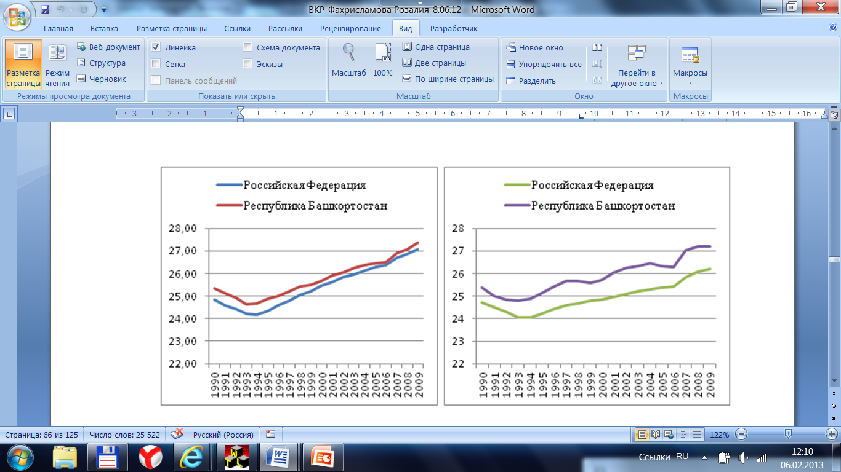
Institute of Demography NRU HSE
How they should not write research papers (course papers, Master’s papers)
Is appearance significant for graphs?
Error No 27 Format of diagram is asymmetric and unnecessary different.
Example
Danger: The reader’s eyes have to pay attention to undue details, not to the entity of main graphic information.
Elimination method – to develop your own standard. Let it be a local one!

Slide 39
Institute of Demography NRU HSE
How they should not write research papers (course papers, Master’s papers)
Is the header significant?
Error No 28 Likening with the yellow press and headers in «МК».
Example: compare
Берегите мужчин! [Take care of men!]
(Б.Ц.Урланис, «ЛГ», 1969 г.)
vs
A Moscowite has a liquid sperm because he does not like the motherland (И.Гундаров, д.м.н. академик РАЕН, «КП», 15 апреля 2002 года [Gundarov, RANS academician, “KP”, 15 April 2002])
See: Почему у москвича сперма жидкая? [Why a Mocowite has a liquid sperm?]
Что мы знаем о лисе? Демоскоп Weekly № 63-64
Humoristic column “What we know about the fox?” Demoscope Weekly http://demoscope.ru/weekly/2002/063/lisa01.php
Elimination method – do not follow…

Slide 40
Institute of Demography NRU HSE
How they should not write research papers (course papers, Master’s papers)
Is a gap so important?
Error No 29 At listing the countries, regions, indicators, ages, etc. some names or values are missed.
Possible sources
Inattentiveness, untidiness, or procedure error
Пример: «8-th» rank of Russia in the world by population size.
See. На каком месте находится Россия? Комментарий Демоскопа: Перепись-2010. Демоскоп Weekly № 491-492, http://demoscope.ru/weekly/2011/0491/perep01.php#2
[What is the rank of Russia? Comment of Demoscope: 2010 Census. Demoscope Weekly #491-492]
Elimination method
Apply the famous Russian proverb «7 раз отмерь, 1 раз отмерь» [7 times measure – cut once] in practice. Score twice before you cut once!

Slide 41
Institute of Demography NRU HSE
How they should not write research papers (course papers, Master’s papers)
Conclusion
For essay, research papers, course and Master’s papers the following are significant:
Contents, Presentation, Structure.
Each of these elements has several essential components. Try to take in account all of them!
Optimal structure of essay:
1,2,3 – different sources used,
4 - own point of view

Slide 42
Institute of Demography NRU HSE
How they should not write research papers (course papers, Master’s papers)
Additional reading
Радаев В.В. Как организовать и представить исследовательский проект: 75 простых правил. М.: ГУ‑ВШЭ, ИНФРА‑М, 2001
Стребков Д.О. Программа дисциплины «Организация, подготовка и презентация социологического исследования» для направления «Социология». НИУ ВШЭ. Факультет социологии. Москва, 2013.

Slide 43
Institute of Demography NRU HSE
How they should not write research papers (course papers, Master’s papers)
Acknowledgements
The author express thanks to
L. Karachurina,
E. Kvasha,
V. Sakevich,
E. Scherbakova
for significant remarks made in due time.

