Slide 1
Demographic databases
Author – Soroko Eugeny
Demoscope Weekly – http://demoscope.ru
NRU HSE > Institute of Demography
Do you need to make notes?
Only address
http://demoscope.ru/weekly/edu/demography.php
English version as of 11-Dec-2015

Slide 2

Demographic databases
The data. What is that?
Quantitative data
Qualitative data
Here: statistical data on population, census results, summary data of vital statistics, results of socio-demographic surveys, population estimates by countries and regions of the world

Slide 3
Demographic databases
The database. What is that?
Software + hardware for: data processing, search, selection, storage, conversion, transfer and transmission.
Currently most of the databases are located on the web.
Components: server, computer, data transmission facilities, operating system, browser, file

Slide 4
Demographic databases
Main types of databases
Hierarchical databases
Relational databases
GIS – geoinformational systems

Slide 5
Demographic databases
How the demographic indicators may be classified?
Micro – Macro
Macroindicators characterize mass social processes, structures, and phenomena
Microindicators are the data on person, family, or household, and personal answers to the survey questionnaire

Slide 6
Demographic databases
How the demographic indicators may be classified?
Absolute – relative indicators
Absolute: population size, number of migrants, number of marriages, number of families, number of unemployed, …
Relative: mortality rate, percentage of population in working ages, rate of migration mobility, crude marriage rate, …

Slide 7
Demographic databases
How the demographic indicators may be classified?
Integral indicators:
total fertility rate,
net reproduction rate,
total abortion rate, …
Age indicators:
age-specific fertility rate,
age-specific mortality rate by cause of death,
marriage rate by sex and age, …

Slide 8
Demographic databases
How the demographic indicators may be classified?
Indicators for describing the size, scale, intensity, speed, structure, or direction of the population processes, …
Indicators for measurement of
population composition,
migration,
fertility,
mortality,
nuptiality,
family structure, …
Socio-economic indicators:
employment, type of pension, source of income,…

Slide 9
Demographic databases
What is the size of table for a given indicator?
Table – N-dimensional one by number of categories:
Territory: country, region, city,…
Period: year, month, 5-10-year period, as of 1 Janyary, census date, midyear,…
Sex: males, females, both sexes
Age group: 0,1,2,… 0-4,5-9,10-14,…
Ethnicity: Russian, Tatar, Bashkir,…
Marital status: married, divorced, never married,…
Cause of death

Slide 10
Demographic databases
Who is the developer of databases?
National statistical services
Rosstat – Federal service of state statistics
Statistics Sweden
Agency of the Repulic of Kazakhstan on statistics
The State Statistical Committee of the Republic of Azerbaijan
Agency on Statistics under President of the Republic of Tajikistan
Türkmenistanyň Statistika baradaky döwlet komiteti
The state committee of the Republic of Uzbekistan on statistics
State Statistics Service of Ukraine
Statistics Lithuania
Statistics New Zealand
Statistics Norway
Central Statistical Bureau of Latvia
…

Slide 11
Demographic databases
Who is the developer of databases?
International Institutions
United Nations:
United Nations Statistical Division – Statistical Databases,
The Population Division of the Department of Economic and Social Affairs of the United Nations: World Population Prospects: The 2015 Revision, …
WHO:
World Health Organization. Regional Office for Europe. Health for All Database
Eurostat:
European Commission > Eurostat> Data> Database> Population
…

Slide 12
Demographic databases
Who is the developer of databases?
International Research Projects
Human Mortality Database
Human Fertility Database
IPUMS - Integrated Public Use Microdata Series, International
74 countries - 238 censuses - 544 million person records
Results of socio-demographic surveys
GGS Gender and Generation Survey (РиДМиЖ)
…
Demographic resources on the web at Demoscope Weekly:
http://demoscope.ru/weekly/app/links.php

Slide 13
Demographic databases
What do we need to know at our work with the databases?
Who is the author? Where can we find it? What is the set of indicators there? For what period? How often the data are updated? How the calculations are made? For what categories the data are given? What is the data format? Is registration required for the user? Is access fee-paying or free?
Where can we find an answer?
Research project “Database of demographic indicators by the regions of Russia and countries of the world " №11-04-0039 funded by “NRU HSE Science Foundation» 2011-2012 http://db.demoscope.ru/bd_sources_di.php
We require at least 20 criteria for characterizing the source of demographic information

Slide 14
Demographic databases
What do we need to know about the indicator?
It is a measure of what?
What is the unit of measurement?
How the indicator was calculated?
How to obtain the indicator required?
Is there any source containing the most precise and correct values?
What is the aim of our query to a database?
Illustration (table of graph) for a separate country
Analysis of trends in a given region
Initial data for further demographic calculations
Inter-country comparisons

Slide 15
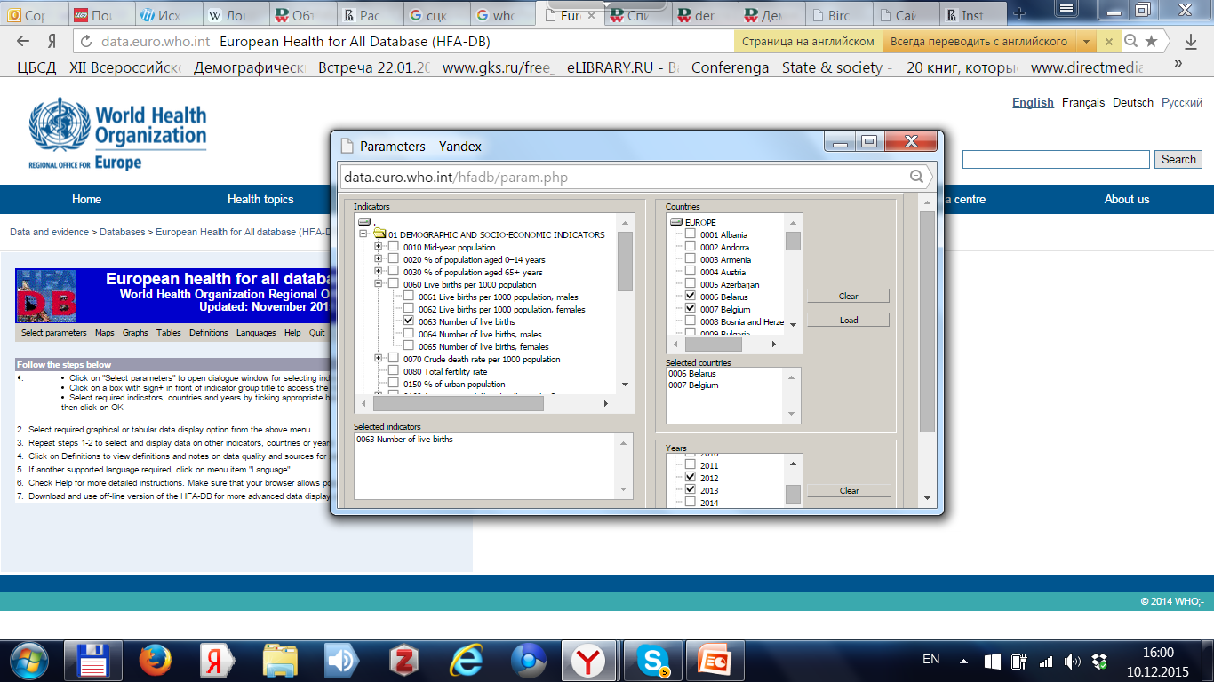
Demographic databases
How a query to the database is being formed?
Example of HFADB - WHO Health for All DB

Slide 16
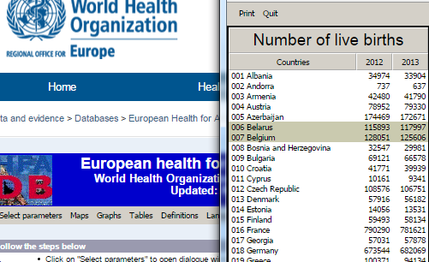
Demographic databases
What is the result of query? Example of WHO HFADB

Slide 17
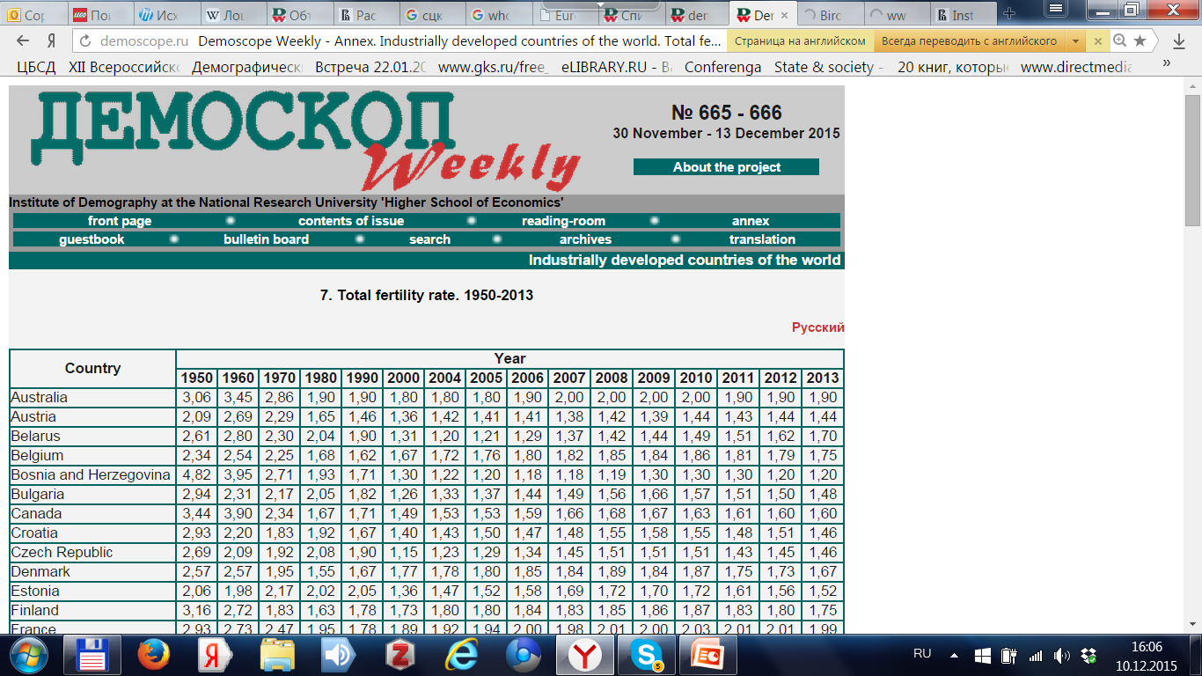
Demographic databases
What are the formats of data? HTML-page

Slide 18
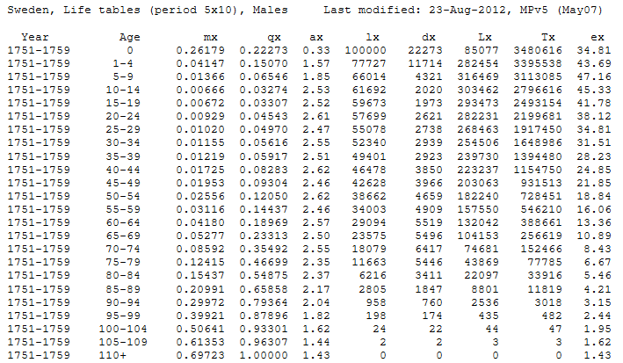
Demographic databases
What are the formats of data? Example: HMD: text file

Slide 19
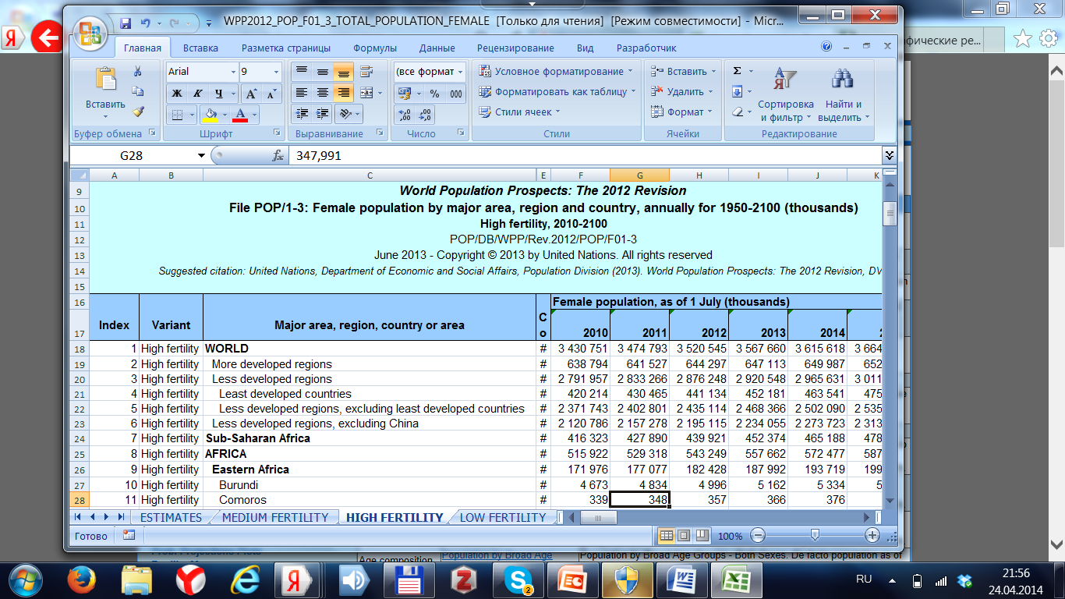
Demographic databases
What are the formats of data? UN WPP: Excel file

Slide 20
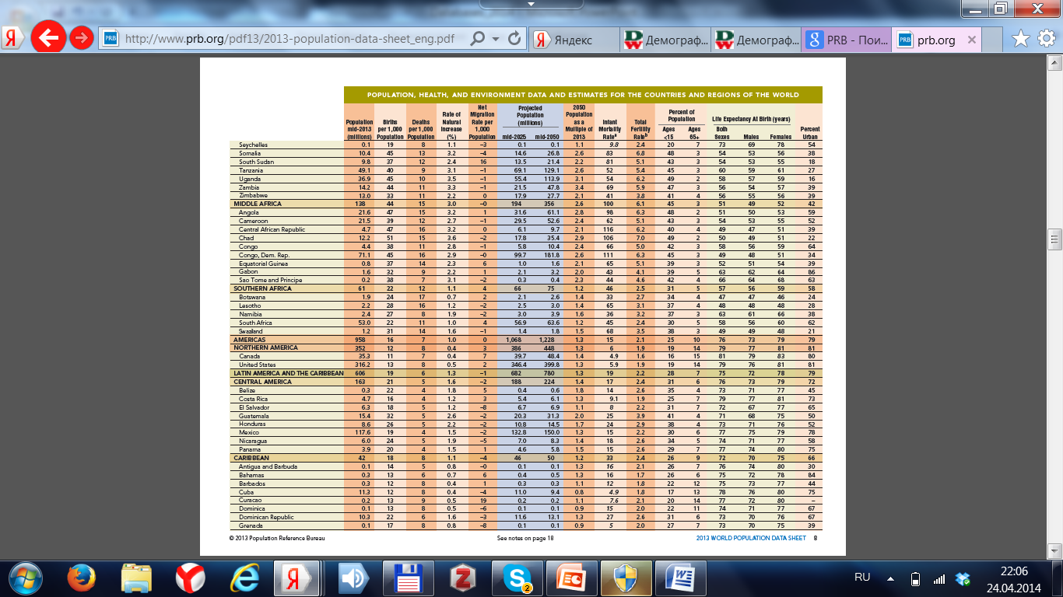
Demographic databases
What are the formats of data? PRB: PDF file.

Slide 21
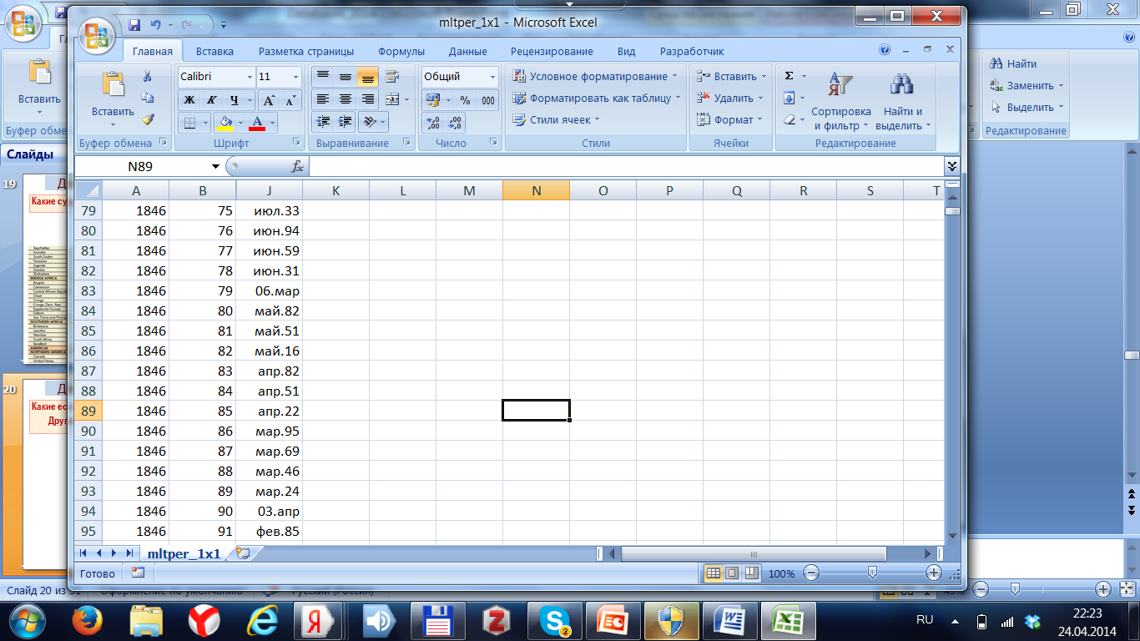
Demographic databases
What pitfalls are waiting for you?
Different decimal delimiters in different MS Office (Windows) after import into Excel

Slide 22
Demographic databases
What pitfalls are waiting for you?
Ambiguity of value of a given indicator for a required combination (country*period*age, etc)
Values in different sources differ
Values in different tables in ONE source differ
Values in ONE source in different time differ
Table 1. Net migration for population of Russia in 1997 according to different sources, persons.
Source | Net migration
Information on socio-economic status of Russia, 1997 | 364600
Demographic yearbook of Russia 2002, T.1.3 | 352600
Demographic yearbook of Russia 2009, T.1.4 | 514100
Demographic yearbook of Russia 2009, T.7.1 | 391127

Slide 23
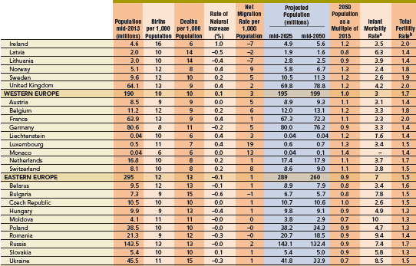
Demographic databases
What pitfalls are waiting for you? Insufficient precision

Slide 24
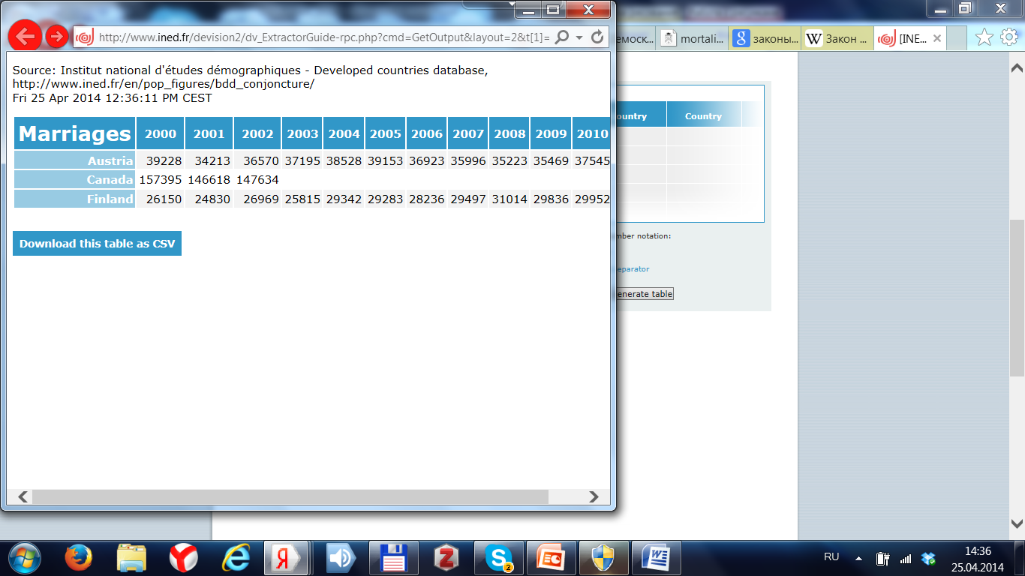
Demographic databases
What pitfalls are waiting for you?
Gaps in the lists (of periods, countries, ages, etc.)

Slide 25
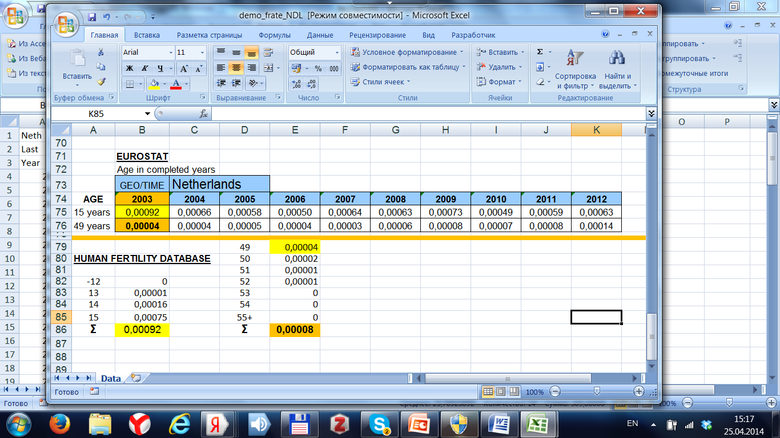
Demographic databases
What pitfalls are waiting for you? Ambiguous categories

Slide 26
Demographic databases
What pitfalls are waiting for you?
Unconventional names of indicator
Суммарный коэффициент рождаемости
Total fertility rate
Total period fertility
Total fertility rate (male) See Statistics Sweden
Synonyms
Crude fertility rate
Births per 1000 population
Crude birth rate
General fertility rate

Slide 27
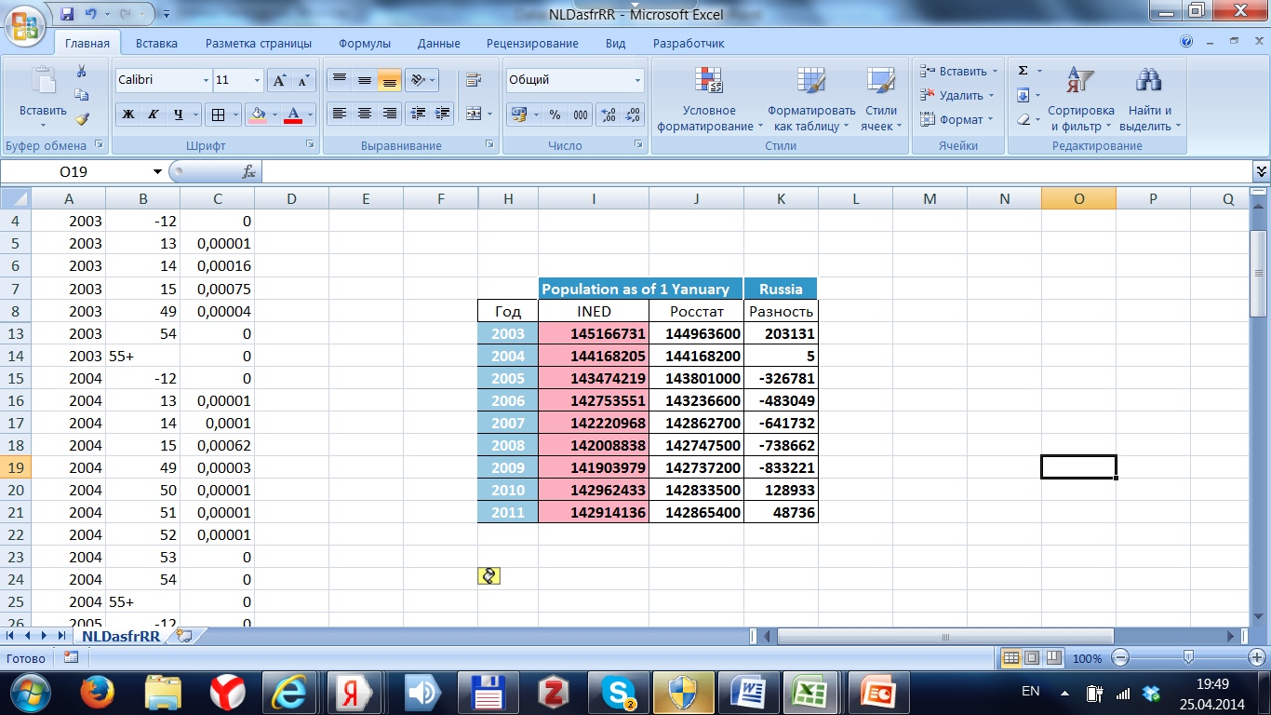
Demographic databases
What pitfalls are waiting for you?
Out-of-date or erroneous data

Slide 28
Demographic databases
What pitfalls are waiting for you?
Political commitment
Kosovo
US Census Bureau. http://www.census.gov/
What to do? Use anonymizer.

Slide 29
Demographic databases
Laws of demographic databases - 40О
What is that?
There exist buttered toast phenomenon, Parkinson's Law, Murphy's Law (Anything that can possibly go wrong, does.),…
Law 1. After the value of the indicator was found in the most reliable source, it is always possible to find a different value in another source, that may cast discredit on the first one.
Law 2. The database contains the indicator we need, but does not include the values just for the country and period we require today.

Slide 30
Demographic databases
Laws of demographic databases
Law 3. At expecting the most accurate population estimates after conducting the census they discover 1 million of persons lost.
Law 4. At looking for 5-year age groups necessary for demographic calculations they find only 1-year age groups in the database, and vise versa.
Law 5. In the most important period for a specific population research in a given country no census was conducted.

Slide 31
Demographic databases
Laws of demographic databases
Law 6. The vital statistics system suspends enumeration of its most significant attributes just in the period of the most serious transformations of population processes.
Law 7. Transition from ICD-9 to ICD-10 took place just in the period of significant changes of mortality for a given cause of death.
Law 8. Urgently needed database is inaccessible, changed the address, or «Under construction» just in the moment required.
Law 9. At processing the thesis the major blunder of copying from the database was done at formulation of the key conclusions.

