Slide 1




Role of Ethnically Mixed Families in Formation of Ethnic Structure of Russia’s Population
Eugeny Soroko
Institute of Demography at the State University Higher School of Economics

Slide 2
Role of Ethnically Mixed Families in Formation of Ethnic Structure of Russia’s Population
Theoretical Background
1.1. Two ethnicities A, B. No mixed families. Different demographic parameters
Dynamics of population size
Dynamics of percentage of ethnicities A, B

Slide 3
Role of Ethnically Mixed Families in Formation of Ethnic Structure of Russia’s Population
1.2. Two ethnicities A, B. No mixed families. Equal or close demographic parameters
Dynamics of percentage of ethnicities A, B

Slide 4
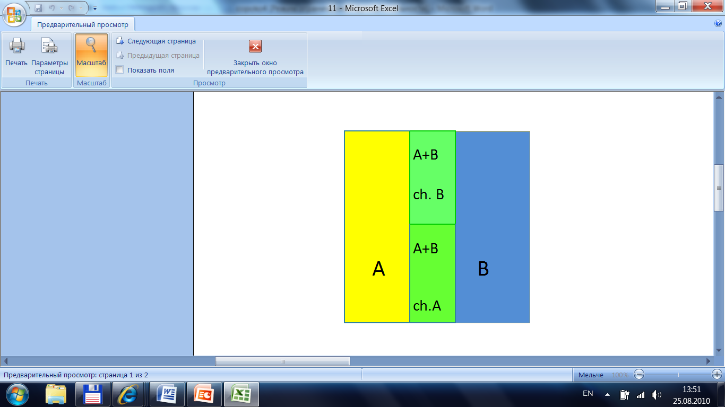
Role of Ethnically Mixed Families in Formation of Ethnic Structure of Russia’s Population
1.3. Two ethnicities A, B. Equal demographic parameters. Some families are ethnically mixed. 50/50 assimilation.
Dynamics of percentage of ethnicities A, B
Mixed families of ethnicities A, B

Slide 5
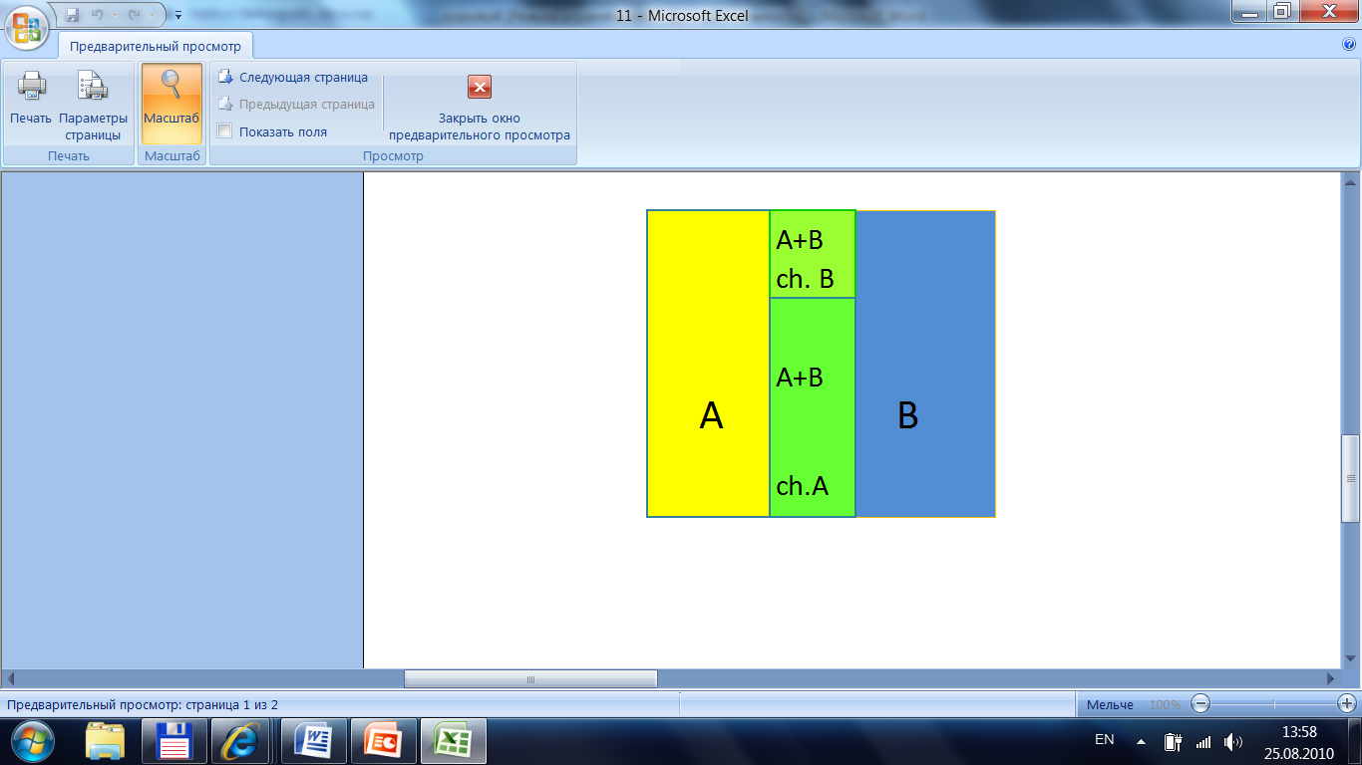
Role of Ethnically Mixed Families in Formation of Ethnic Structure of Russia’s Population
1.4. Two ethnicities A, B. Equal demographic parameters. Some families are ethnically mixed.
Number of children A more than B in mixed families
Dynamics of percentage of ethnicities A, B
Mixed families of ethnicities A, B

Slide 6
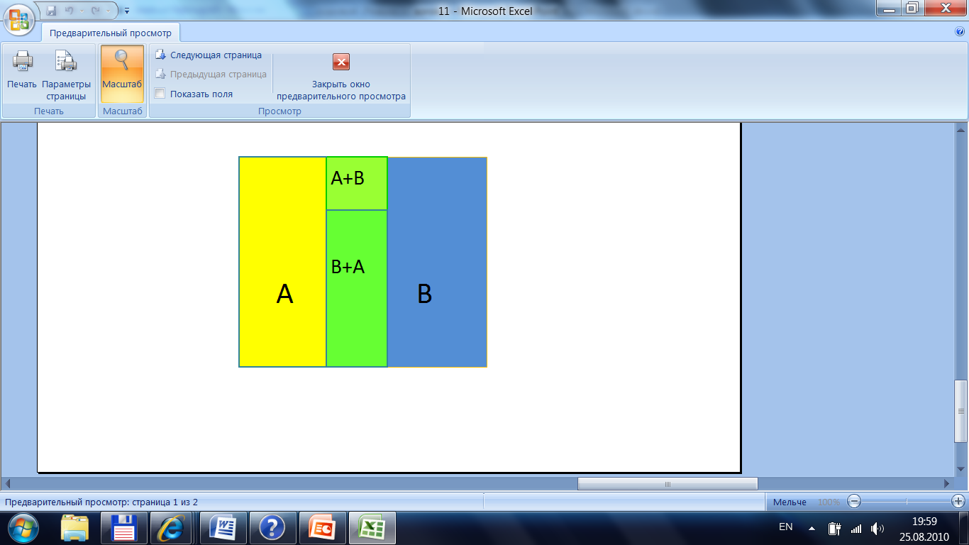
Role of Ethnically Mixed Families in Formation of Ethnic Structure of Russia’s Population
1.5. Two ethnicities A, B. Equal demographic parameters. Some families are ethnically mixed.
Sex asymmetry at formation of mixed family:
Number of B+A families are more than A+B
Mixed families of ethnicities A, B

Slide 7
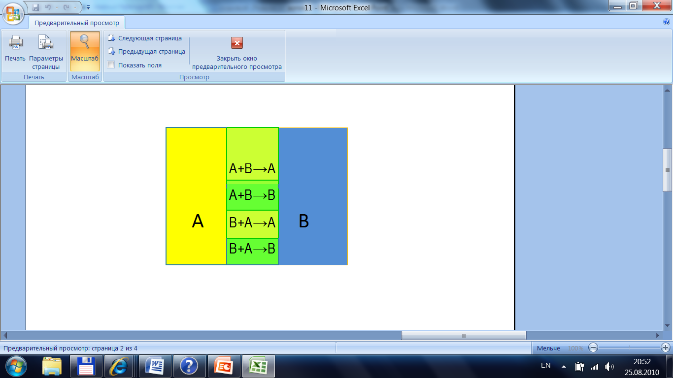
Role of Ethnically Mixed Families in Formation of Ethnic Structure of Russia’s Population
1.6. Two ethnicities A, B. Equal demographic parameters. Some families are ethnically mixed.
Sex asymmetry of direction of assimilation:
Percentage of children A in family with farther A and mother B is more than in father B and mother A
Mixed families of ethnicities A, B

Slide 8
Role of Ethnically Mixed Families in Formation of Ethnic Structure of Russia’s Population
1.7. Two selected ethnicities A, B in a multi-ethnic country.
Some families are ethnically mixed (A+B).
Number of them is proportional to the population size of ethnicity A and size of ethnicity B
A
B
A-B ‘distance’
Mixed families (A+B) in a multi-ethnic country
D(A,B) is short for N(A,B) >> k*P(A) * P(B)
D is long for N(A,B) << k*P(A) * P(B)

Slide 9
Role of Ethnically Mixed Families in Formation of Ethnic Structure of Russia’s Population
1.8. Two selected ethnicities A, B in a multi-ethnic country.
A
A+B→A
A+B→B
B
Mixed families (A+B) in a multi-ethnic country
Assimilation has two directions similar to immigration and emigration.
The result of them is similar to net migration for a given ethnicity A.

Slide 10
Role of Ethnically Mixed Families in Formation of Ethnic Structure of Russia’s Population
1.9. Generalized equation of population balance should take into account the result of assimilation
A
E
E
A – result of assimilation in mixed families
P - population size of ethnicity E
B – births, D – deaths, M - migration

Slide 11
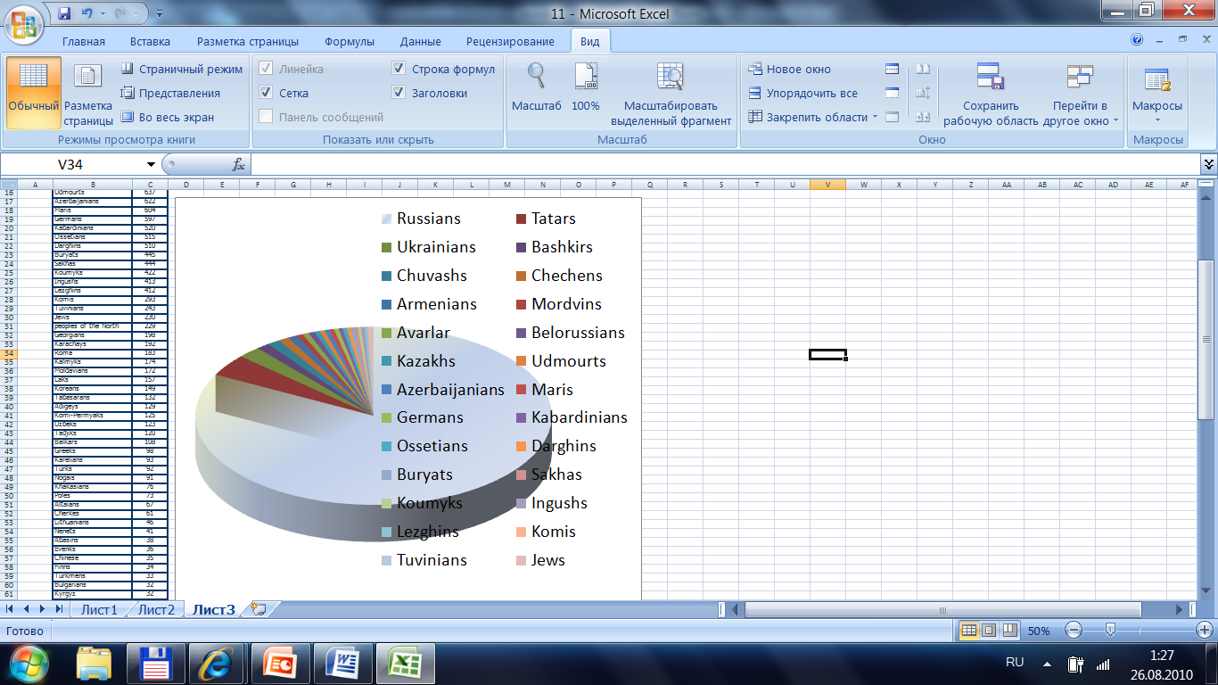
Role of Ethnically Mixed Families in Formation of Ethnic Structure of Russia’s Population
2. Current ethnic structure of the population in Russia
Top 26 peoples

Slide 12
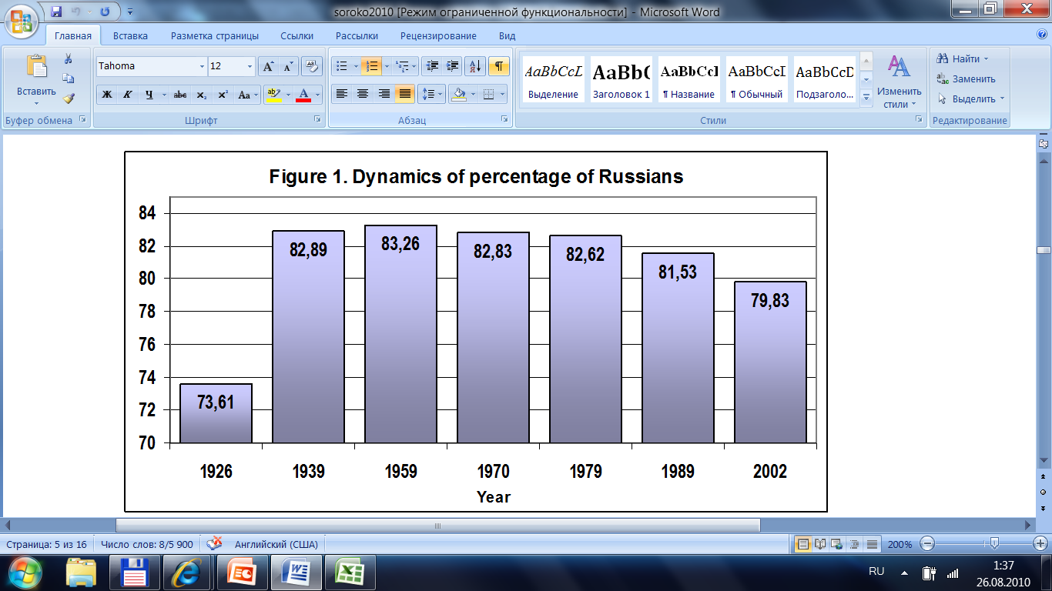
Role of Ethnically Mixed Families in Formation of Ethnic Structure of Russia’s Population
2.1. General features
Total number of ethnicities is about 200.
A hundred of them have size of one thousand.
7 peoples sized 1 million and more:
Russians, Tatars, Ukrainians, Bashkirs, Chuvashs, Chechens, and Armenians.
Russians are about 80 per cent.

Slide 13
Role of Ethnically Mixed Families in Formation of Ethnic Structure of Russia’s Population
2.2. Five groups of peoples:
1 - Bashkirs, Mordvins, Tatars, Chechens, Chuvashs, Lezghins, Darghins, Avarlar, Koumyks, Kabardinians, Tuvinians, and other living on the territory of Russia for centuries
2 - Peoples of ex-USSR: Ukrainians, Armenians, Belorussians, Kazakhs, Azerbaijanians, Georgians, Moldavians, Uzbeks, Tadjiks, Lithuanians, Turkmens, Kyrgyz, Letts, Abkhasians, Karakalpaks, Gagauz. Total size is 7 million.
3 – Peoples outside ex-USSR: Vietnamese, Chinese, Turks, Kurds, Afghans, Arabs (200 thousand)
4 – Germans, Jews (0.5 per cent)
5 - Serbs, Croatians, Romanians, Bulgarians, Poles, Hungarians, Finns, Austrians, etc. (160 thousand)

Slide 14
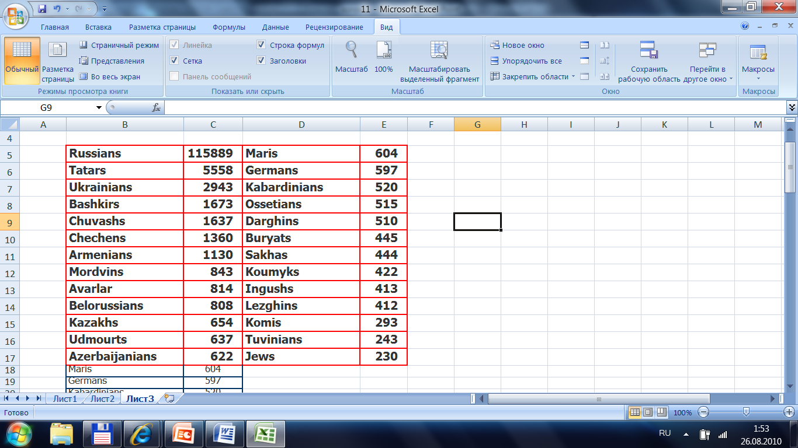
Role of Ethnically Mixed Families in Formation of Ethnic Structure of Russia’s Population
2.3. Top 26 ethnicities. Russia, 2002, thousands

Slide 15
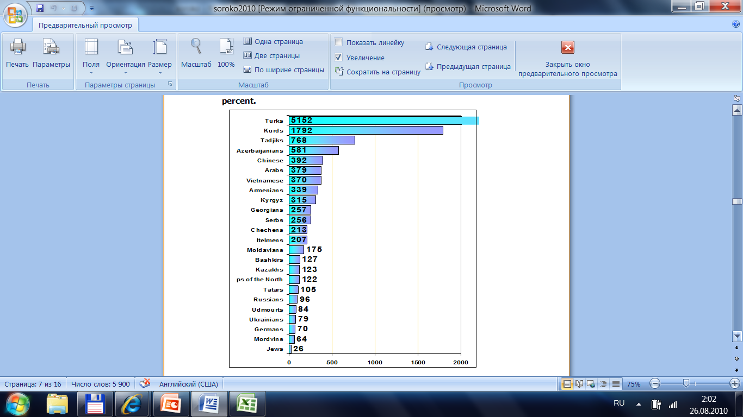
Role of Ethnically Mixed Families in Formation of Ethnic Structure of Russia’s Population
2.4. Change in the proportion of ethnic groups between 1970 and 2002, percent

Slide 16
3. The role of mixed families
3.1. Data and methods
1994 microcensus individual database:
7 million persons (5 per cent) were covered.
1 749 906 marital pairs .
Demographic characteristics used: age, sex, marital status, ethnicity, children born, a set of household members
Special computer software was developed.

Slide 17
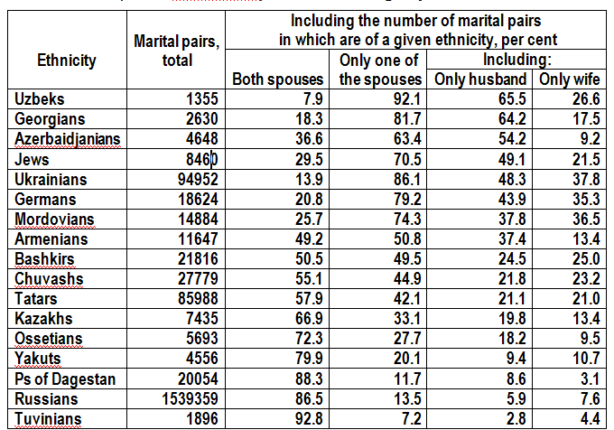
3. The role of mixed families
3.1. Ethnic homogeneity of marital pairs. Selected ethnicities

Slide 18
3. The role of mixed families
3.2. Ratio of mono-ethnic to multiethnic families
Selected ethnicities: poles and the center
Uzbeks 1:12
Georgians 1:4
Mordovians 1:3
Armenians 1:1
Bashkirs 1:1
Kazakhs 2:1
Yakuts 4:1
Tuvinians 13:1

Slide 19
3. The role of mixed families
3.3. Sex asymmetry at mixed family formation.
Ratio of families with husband of a given ethnicity
to 100 families with wife of this ethnicity

Slide 20
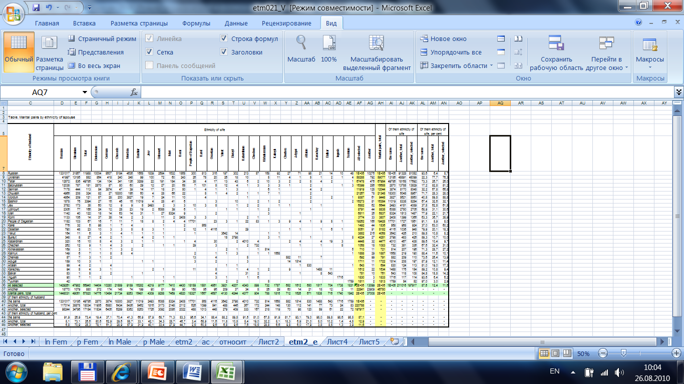
3. The role of mixed families
3.4. Matrix of mixed families by ethnicity of husband and wife

Slide 21
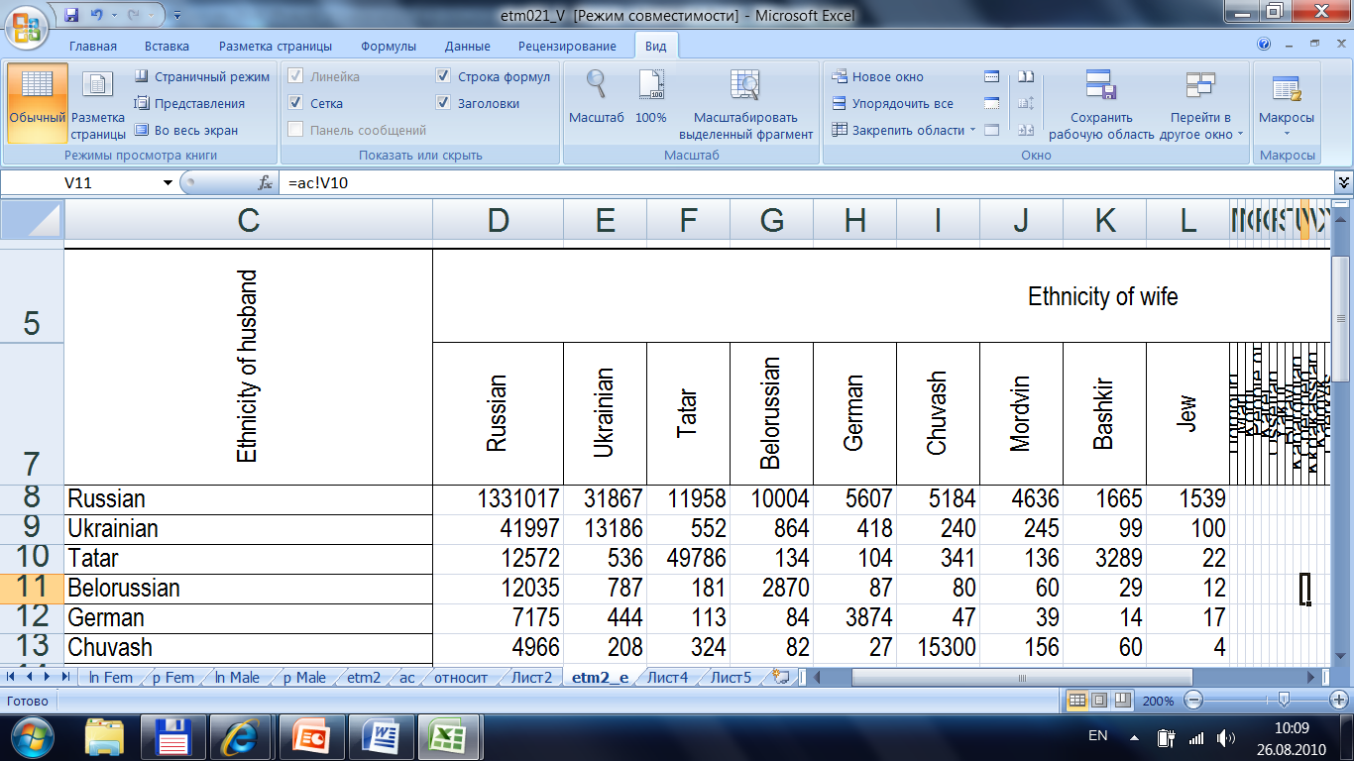
3. The role of mixed families
3.4. Matrix of mixed families by ethnicity of husband and wife

Slide 22
3. The role of mixed families
3.5. Combinations of ethnicities with small sex asymmetry. Examples
Number of given pairs (husband – wife):
Tatar-Bashkir (Bashkir-Tatar) – 3289 (3394)
Cherkes-Adygei – 11 (14)
Karel-Belorussian – 95 (101)
Ingush-Chechen – 6 (5)
Balkar-Karachay – 8 (11)
Kabardinian-Balkar – 19 (31)

Slide 23
3. The role of mixed families
3.6. Combinations of ethnicities with high sex asymmetry. Examples
Husband – wife:
peoples of Dagestan-Chechen – 83 (29)
Belorussian-Komi – 65 (37)
Karachai-Russian – 94 (21)
Adygei-Russian – 159 (71)
Osetian-Ukrainian – 48 (20)
Belorussian-Yakut – 12 (3)

Slide 24
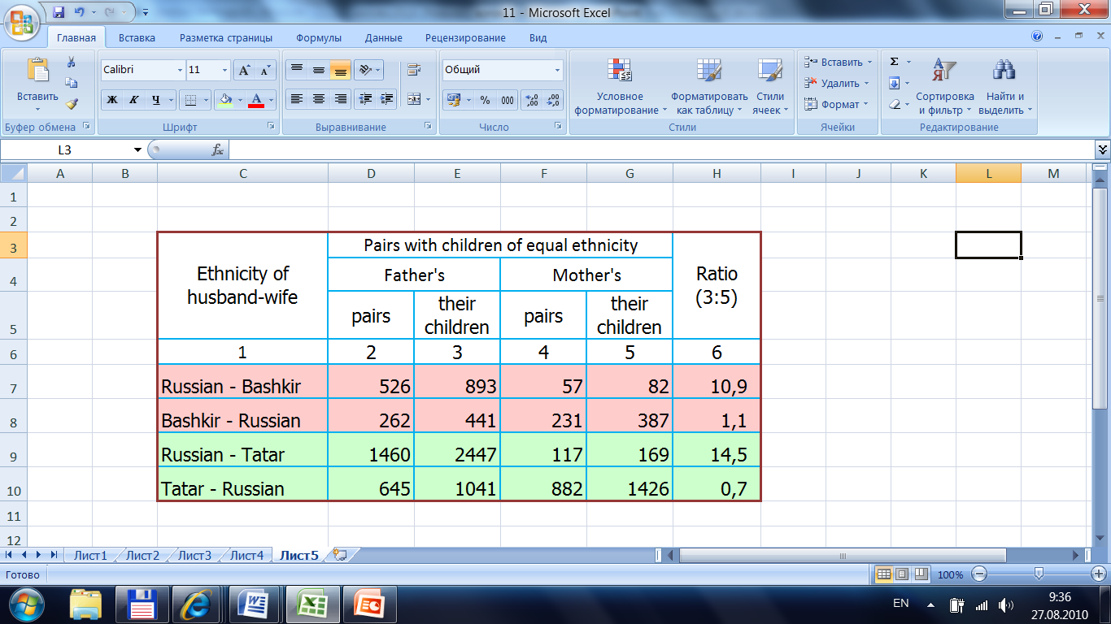
3. The role of mixed families
3.7. Ethnically mixed marital pairs with children by ethnicity of children in Bashkortostan, Orenburg, Chelyabinsk regions. Selected ethnicities

Slide 25
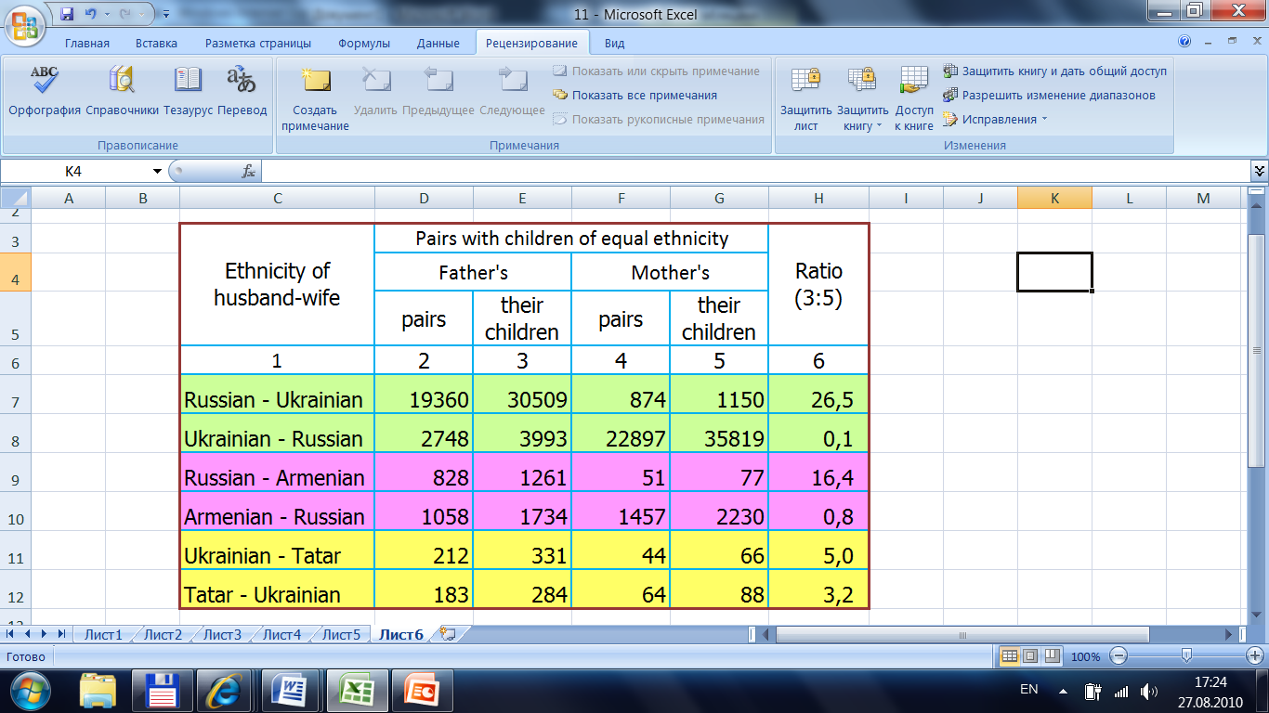
3. The role of mixed families
3.8. Ethnically mixed marital pairs with children by ethnicity of children. Russia, 1994, selected ethnicities

Slide 26
4. Conclusion
In a multiethnic country in the era of low fertility the influence of mixed families upon the ethnic profile becomes rather significant.
Analysis of these families in Russia shows a definite sex and ethnic asymmetry both at the stage of family formation and in the process of assimilation.
Along with ethnic differentiation of fertility, mortality, migration these processes lead to some shifts in country’s ethnic profile and should be taken into account in the projections of future population structure.
The details of these processes are not well studied yet and need more in-depth investigation, including utilizing of micro-data of the censuses.

Slide 27
5. Open questions
  What are the main factors and the formula of generalized distance between ethnicities in the ethnic space, that defines the intensity of mixed family formation and direction of assimilation?
  Do we need the measurement, analysis, and projection of demographic characteristics of the population in a large country not only by age, sex, territory, education, etc., but also by ethnicity?
  Is it possible to establish a new concept of so-called
  “2.5 demographic transition”, that tries to explain shifts in the ethnic structure due to not only differentiation of “classic” demographic processes but also to formation of ethnically mixed families and assimilation?

Slide 28
6. See also
  Visit http://www.demoscope.ru/center/so/epc2010.html
  for additional information and details.
  Use please email address esoroko@hse.ru for any remarks and messages to the author dealing with the topics mentioned in the paper.
THE END.
THANK YOU!

